Slide 1
Cytovance & OU Collaboration

Slide 2
CHO Cell Line Development
Chinese hamster ovary (CHO) cells are an epithelial cell line derived from the ovary of Chinse hamster.
Commonly used in the production of recombinant proteins
Used in biological and medical research
Commercially in the production of therapeutic proteins
Cytovance utilizes two strains of CHO: CHO-S & CHO-KC
Goal: to optimize cultivation process to increase protein titer/concentration

Slide 3
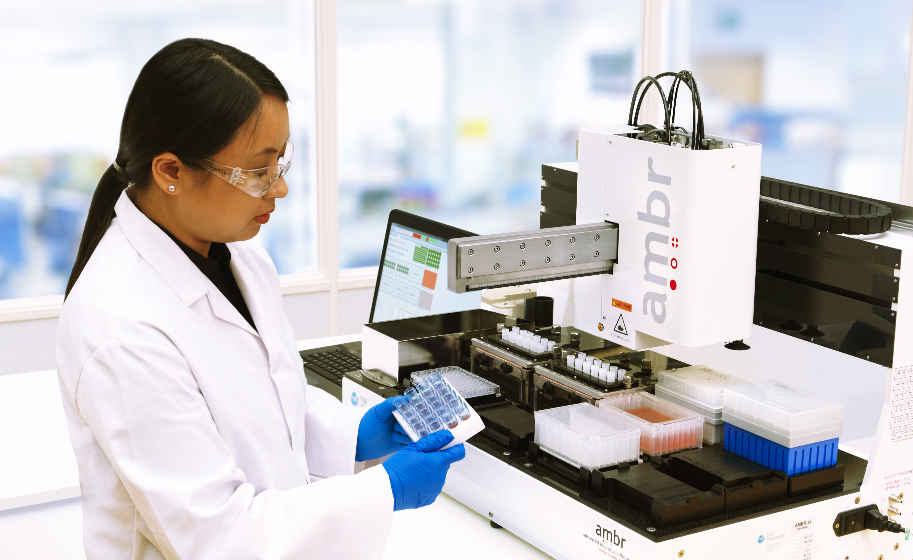
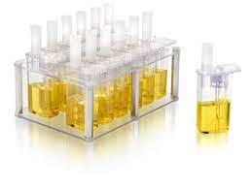
Vessels Types
AMBR15: 14 mL

Slide 4
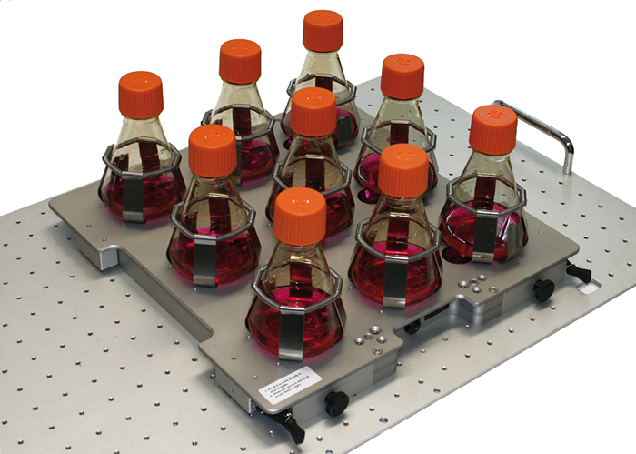
Vessels Types
Shake Flask: 75 mL

Slide 5
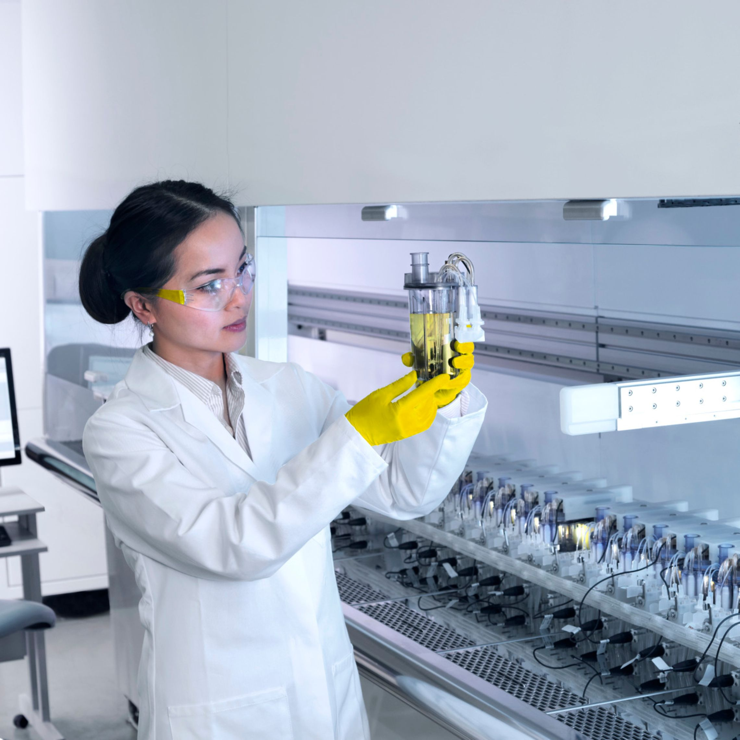
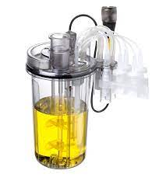
Vessels Types
AMBR250: 200 mL

Slide 6
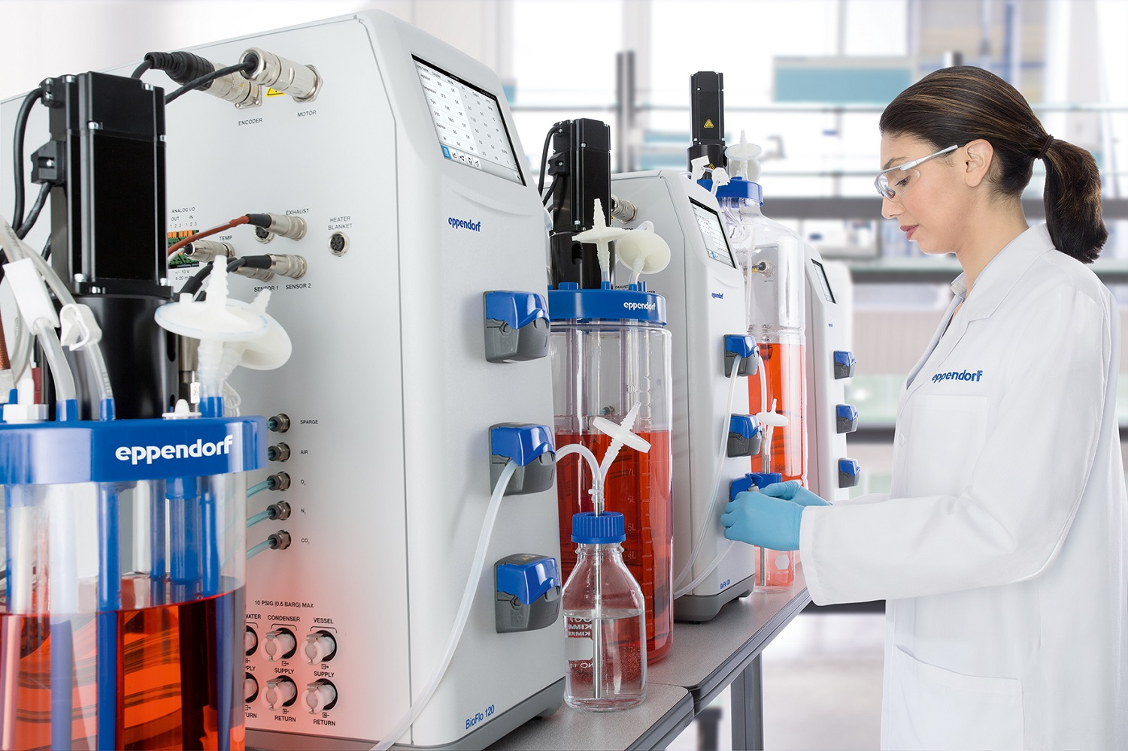
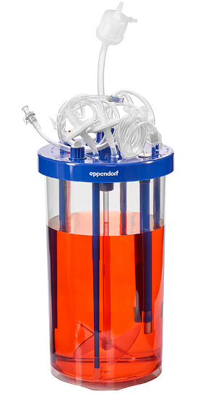
Vessels Types
3c Bioreactor: 3.75L

Slide 7

Independent/Input Variables
Vessel Type: The size vessel used to run the experiment
AMBR15, Shake Flask, AMBR250, or 3c Eppendorf Bioreactor
Vessel Name: how the vessels are labeled/numbered for identification
Supplement: additional supplement that is added that is not included in the media or feed
Dissolved Oxygen (DO): the amount of oxygen (%) to be present during the experiment
pH Setpoint: where the pH is set for the experiment
Temperature: where the temperature is set for the vessel, culture station, or incubator

Slide 8
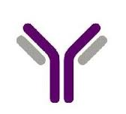
Independent/Input Variables
Target Cell Seeding Density: the number of cells calculated to start the experiment
Media Type: the type of commercial media used
Feed Type: the type of commercial feed used
Feeding Interval: how often the cells were fed
Feed Added: how much feed (%) was added
Glucose Trigger Limit: the lowest concentration of glucose at which to add more glucose

